Slide 1
Luan Vu
Mohammad Hanaee
Alejandra Paredes
Rustam Zulkharov
Stress Level

Slide 2
Introduction
We set out to find if certain environment factors affect students stress level more than others.
UMD CP Vs. USG

Slide 3
Data Collection
Collected through non-mandatory surveys
Used Slack, and Email to distribute.
Used Google Forms to collect and organize data

Slide 4
Hypotheses
Expect to see correlation between every independent variable and dependent
We believe commute time will be the strongest indicator of stress level

Slide 5
Survey Deployment
Here’s a link to our survey (that several of you exercised your right as a free American to NOT take)
We got a total of 70 Responses
18 from USG
52 from UMCP

Slide 6
Methodology
R-Studio
Used R studio to analyze our data. We used linear regression models (function lm() in R), and did summaries of those regression models.
Excel-python
In terms of visualization, we primarily used a combination of python coding and excel to create representations of our results.

Slide 7
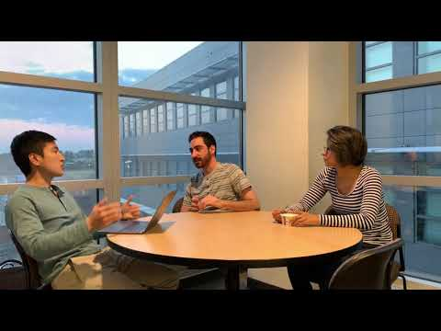

Slide 8
The Results

Slide 9
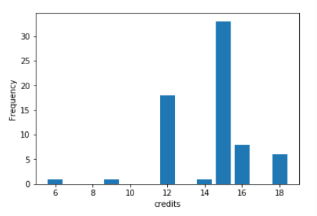
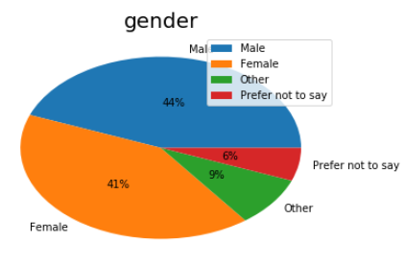
Credits AND Gender

Slide 10
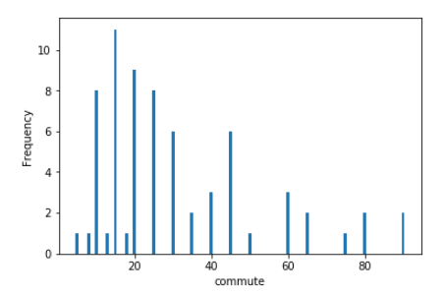
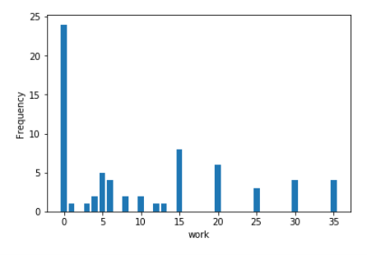
Commute AND Work Frequency

Slide 11
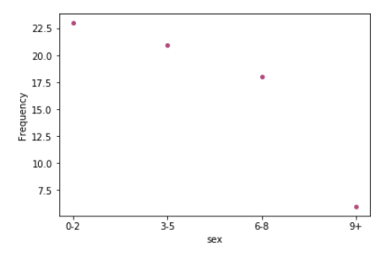
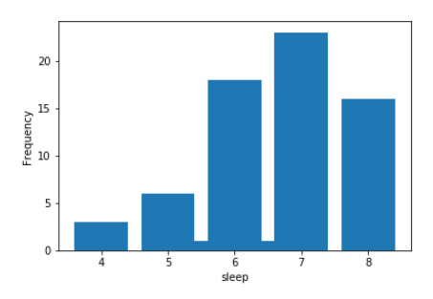
Sex AND Sleep

Slide 12
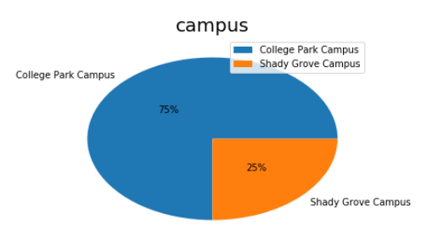
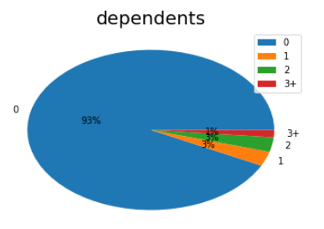
Campus AND Dependents

Slide 13
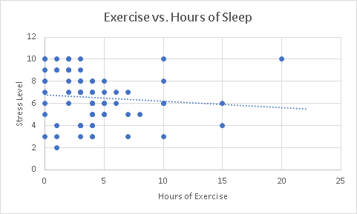
EXERCISE

Slide 14
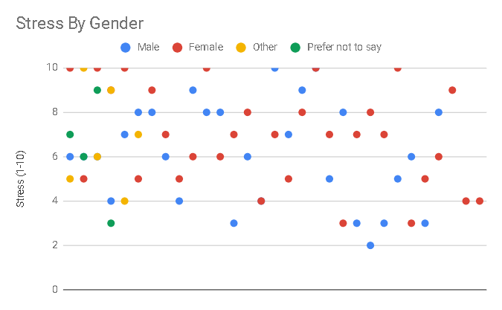
Stress by Gender

Slide 15
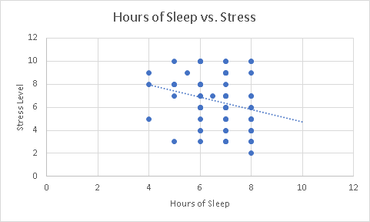
Sleep

Slide 16
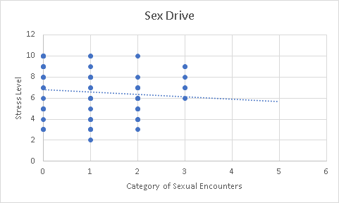
Sex Drive
Categories:
0: 0-2
1: 3-5
2: 6-8
3: 9+

Slide 17
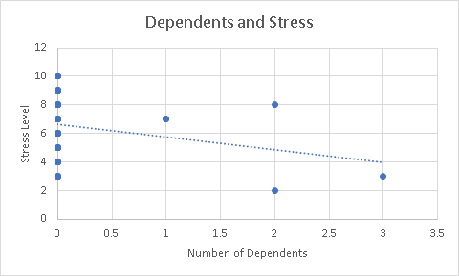
Dependents

Slide 18
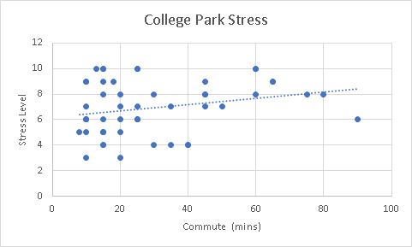
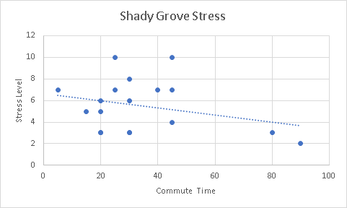
Commutes

Slide 19
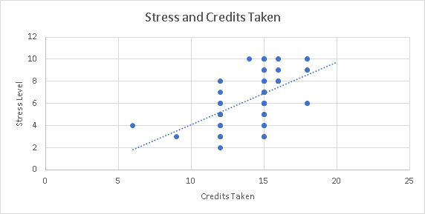
Credits and Stress Level

Slide 20
Thank you!
Any questions?

